Slide 1
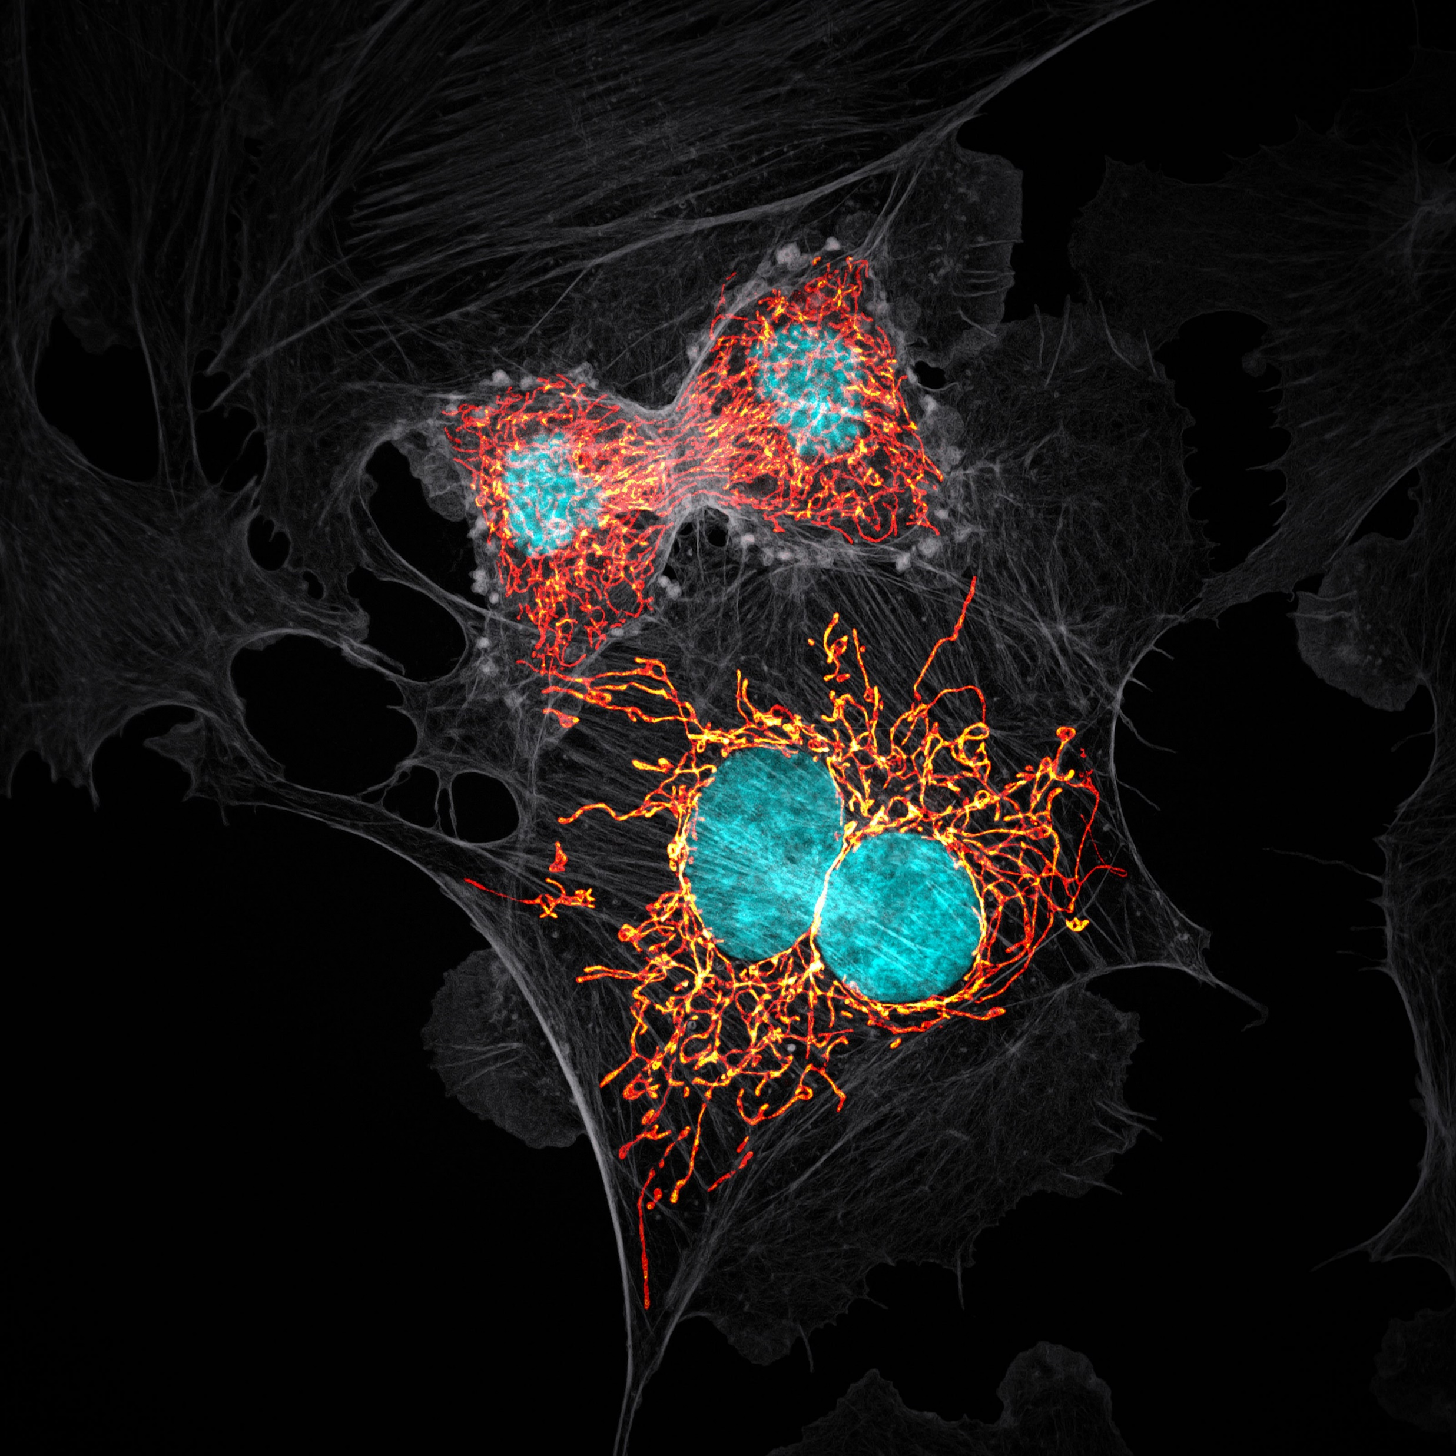

Seeing Is Not Believing
Image Credit: Jason Kirk - Baylor College of Medicine
Nikon Small World 2019 Prize Winner
The Case For Automating Image Analysis
Dave Barry • Francis Crick Institute

Slide 2


Slide 3
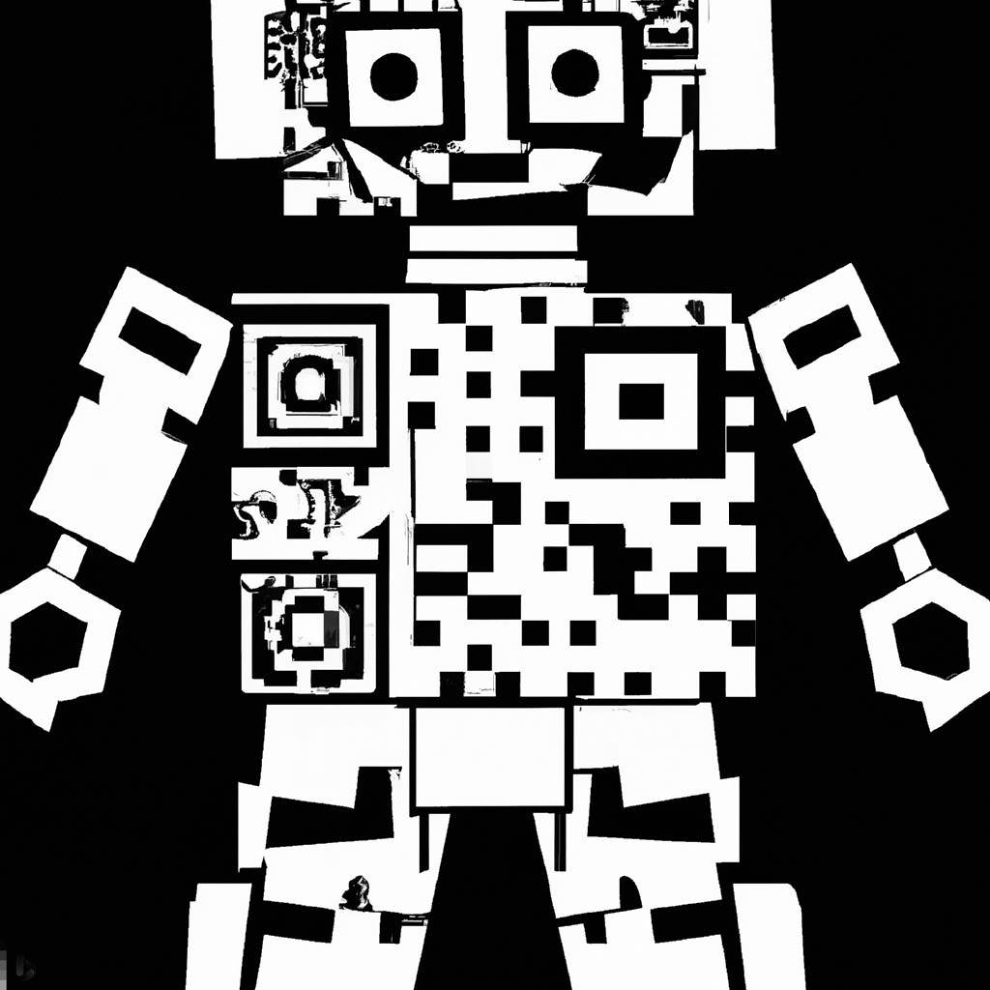
Have your phones ready to scan!

Slide 4
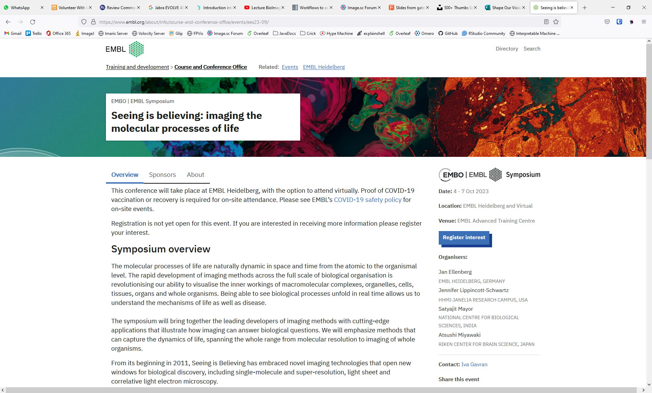

Slide 6
Rule #1: Seeing is believing

Slide 7
Rule #1: Seeing is believing?

Slide 8
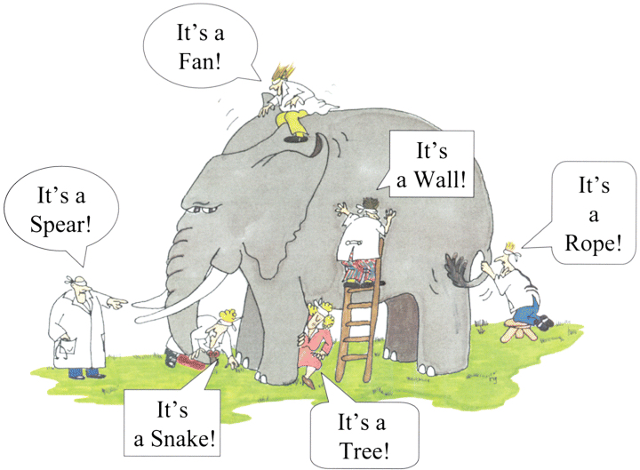

Slide 9
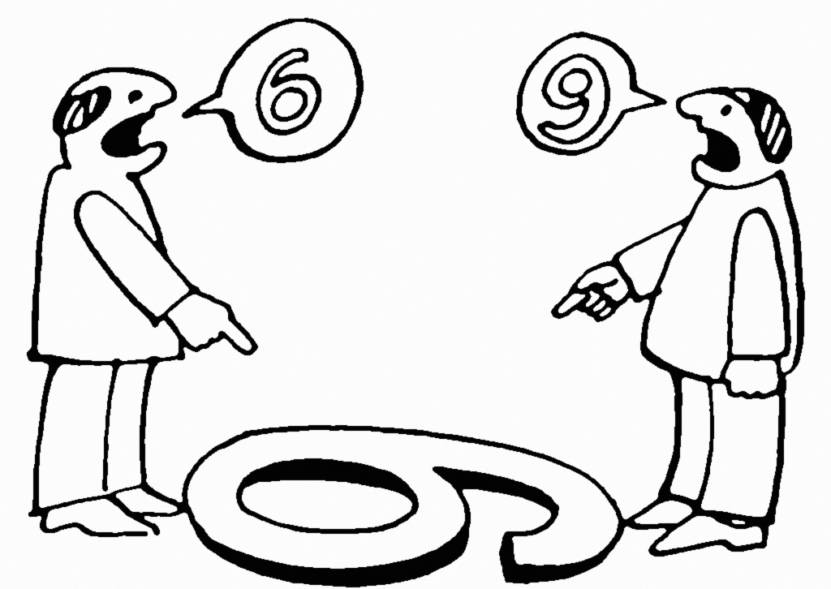
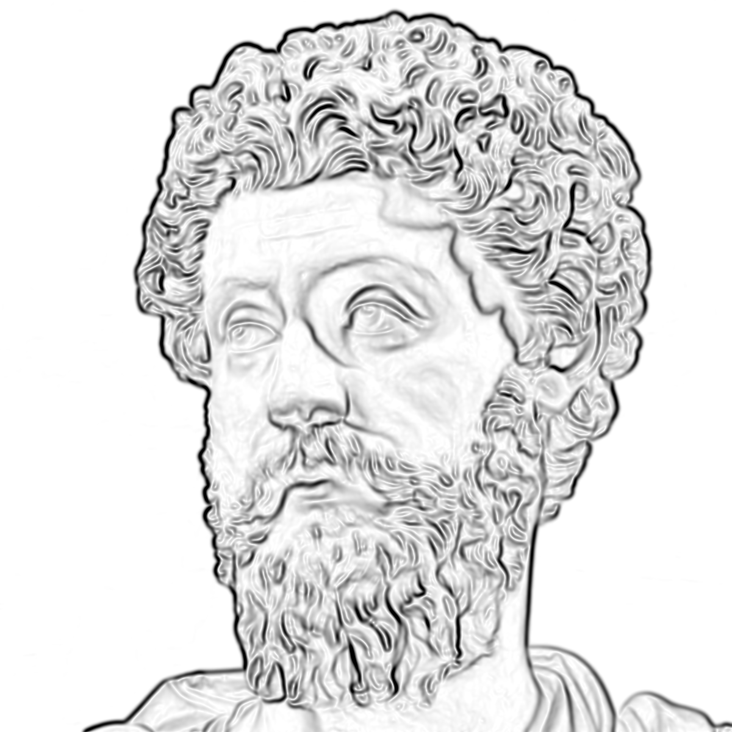
Everything we see is a perspective, not the truth

Slide 10


Slide 11

Quiz 1: For 1 Point, How many colours Are There?

Slide 12
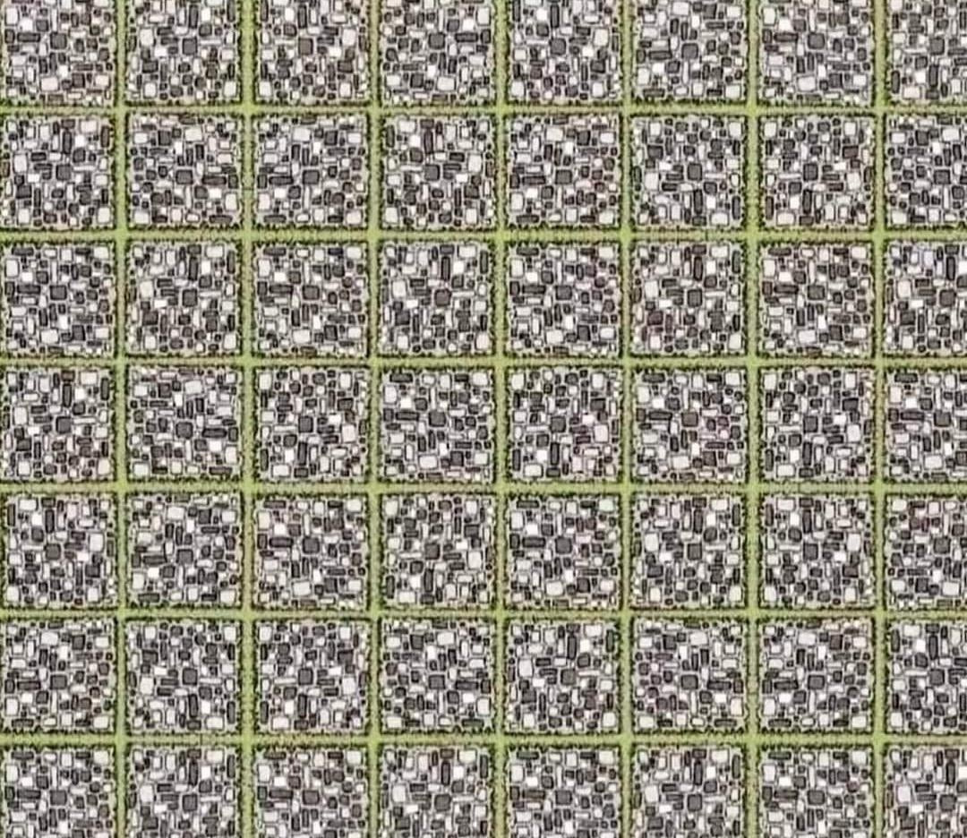

Slide 13



Slide 14
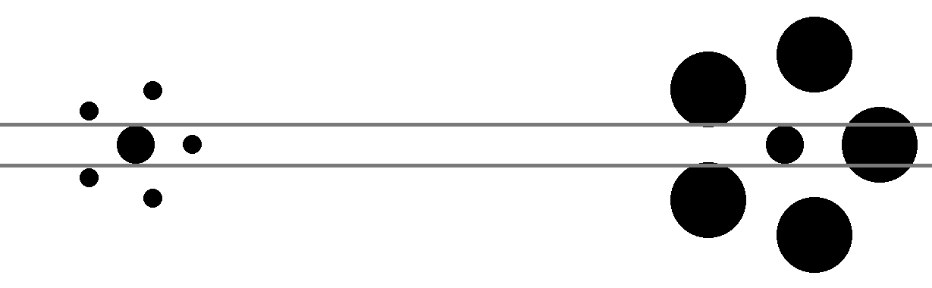


Slide 15
Rule #1: Seeing is believing?

Slide 16
Rule #1: Seeing is not believing

Slide 17
Rule #2: The image is not the result

Slide 18
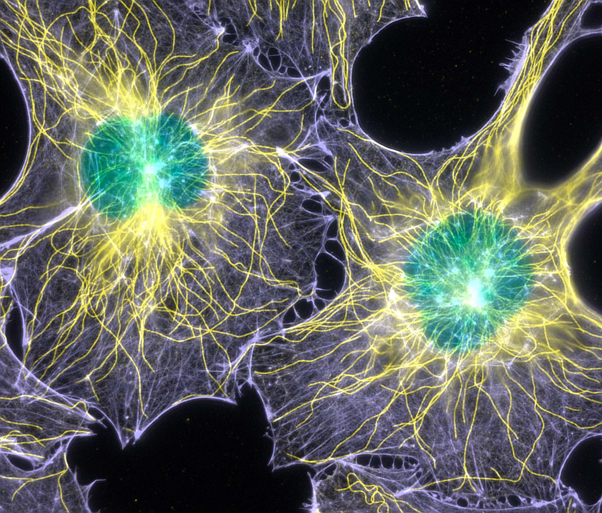
Credit: Torsten Wittmann - Scripps Research Institute
Nikon Small World 2003 Prize Winner

Slide 19
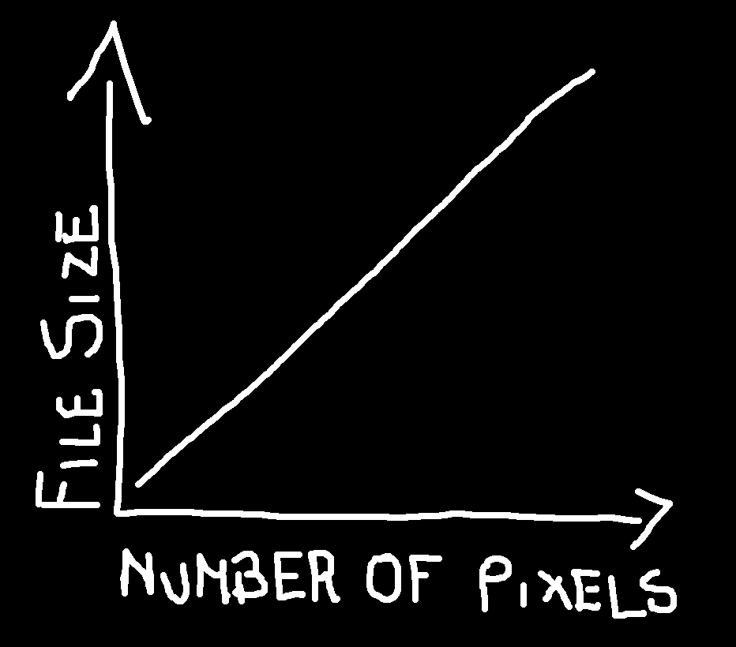

Slide 20
Credit: Torsten Wittmann - Scripps Research Institute
Nikon Small World 2003 Prize Winner

Slide 21
Rule #3: Analysing “by eye” is a really bad idea

Slide 22
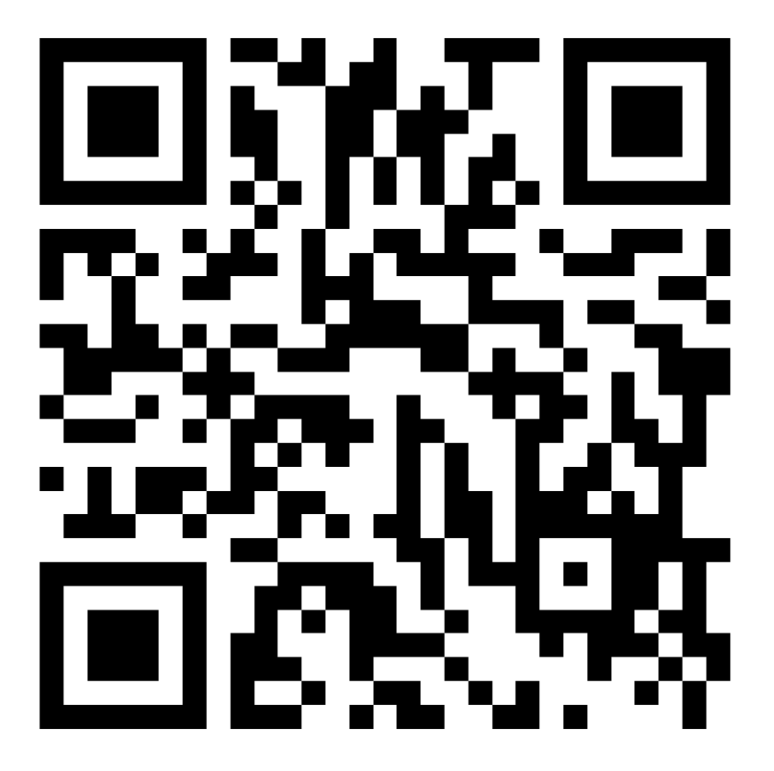

Slide 23
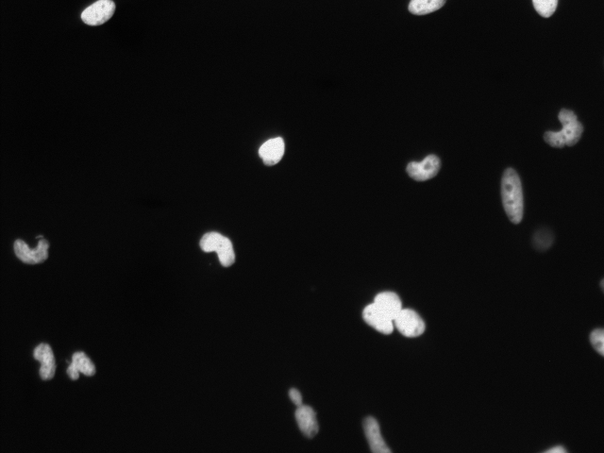
First Quiz: How many nuclei are there?
Notes:
5 minutes, 0 points

Slide 24
First Quiz: How many nuclei are there?
Notes:
5 minutes, 0 points

Slide 25
First Quiz: How many nuclei are there?
Notes:
5 minutes, 0 points

Slide 26
First Quiz: How many nuclei are there?
Notes:
5 minutes, 0 points

Slide 27
First Quiz: How many nuclei are there?
Notes:
5 minutes, 0 points

Slide 28
First Quiz: How many nuclei are there?
Notes:
5 minutes, 0 points

Slide 29
First Quiz: How many nuclei are there?
Notes:
5 minutes, 0 points

Slide 30
First Quiz: How many nuclei are there?
Notes:
5 minutes, 0 points

Slide 31
First Quiz: How many nuclei are there?
Only count round objects
Don’t count objects at edge of image
Don’t count objects below a certain intensity level
Don’t count clumps of objects as one
Notes:
5 minutes, 0 points

Slide 32
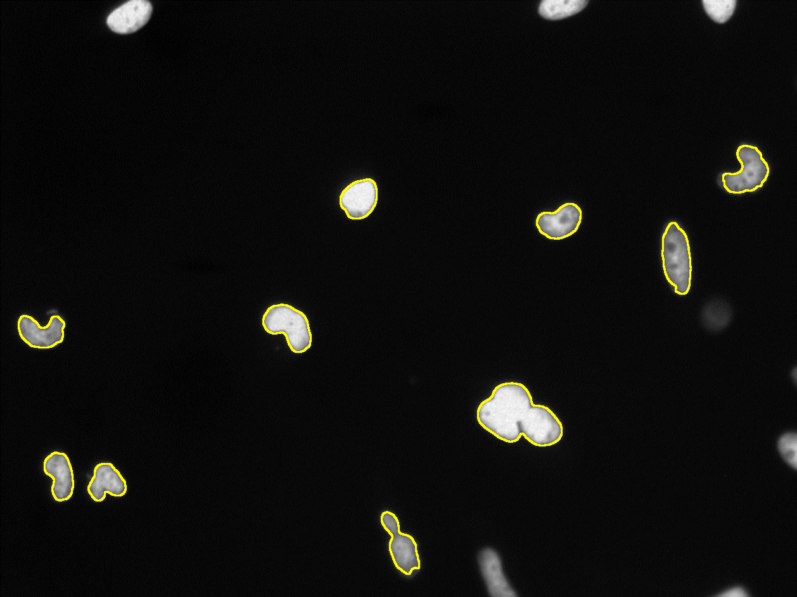
First Quiz: How many nuclei are there?
run("Median...", "radius=2");
setAutoThreshold("IsoData dark no-reset");
run("Convert to Mask");
run("Analyze Particles...", "show=Outlines exclude summarize");
Notes:
5 minutes, 0 points

Slide 33
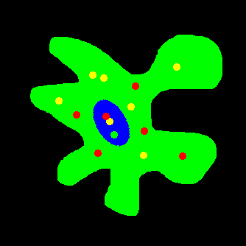
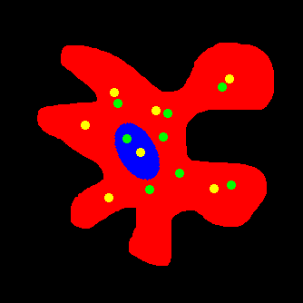
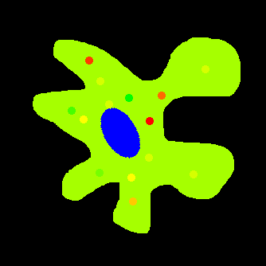

Slide 34
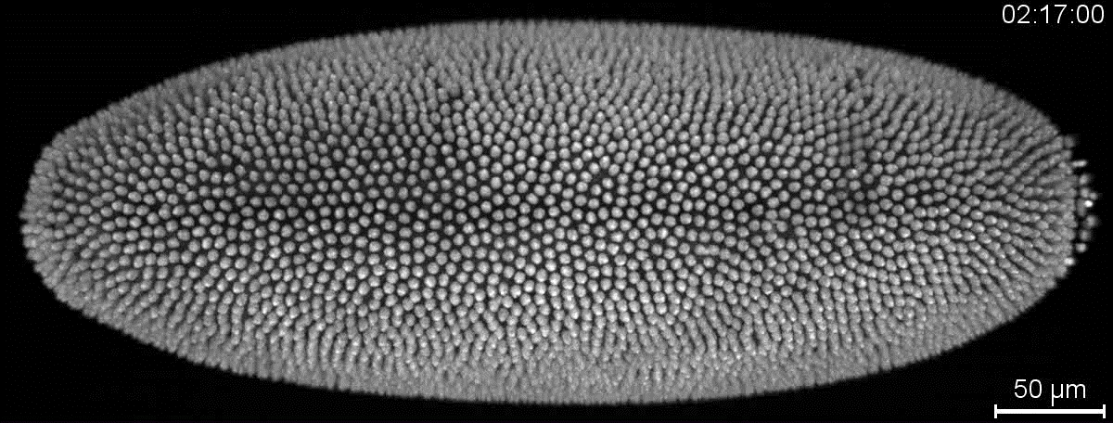
Amat et al., Nat Meth, 2014

Slide 35
Rule #4: Image analysis is hard…

Slide 36
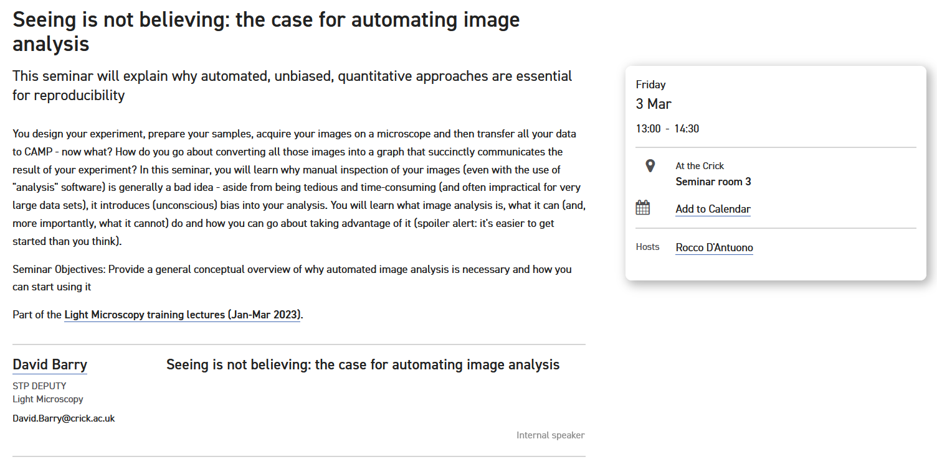

Slide 37
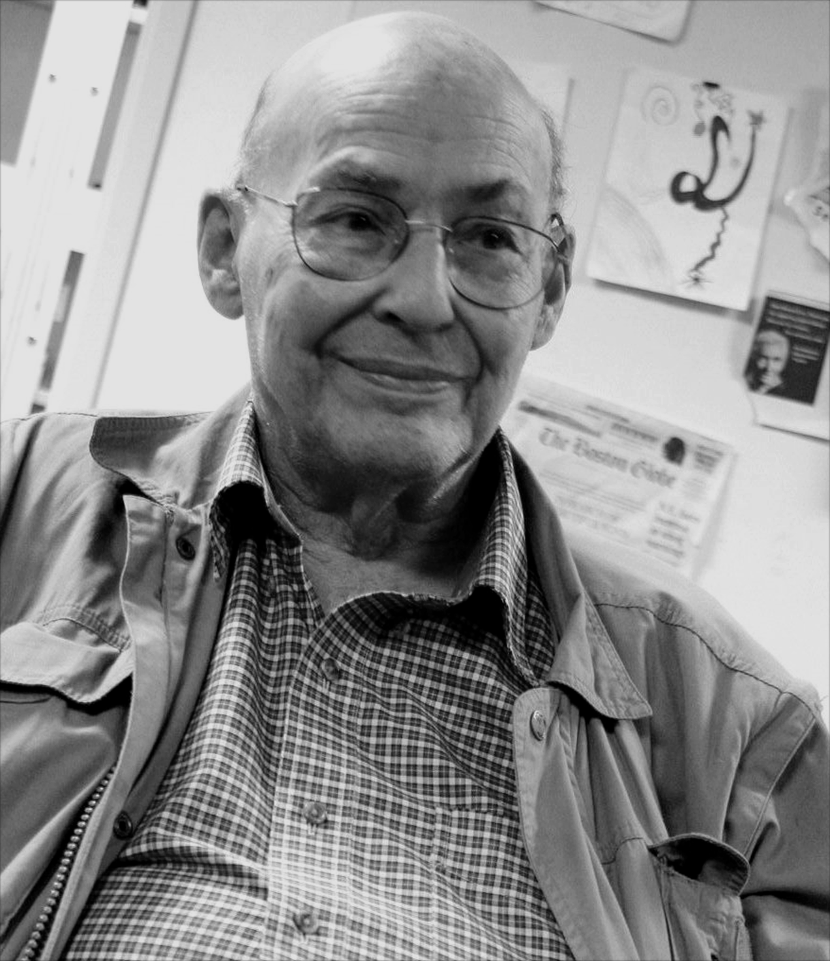
“Connect a camera to a computer and have it describe what it sees”
Marvin Minsky, 1966

Slide 38

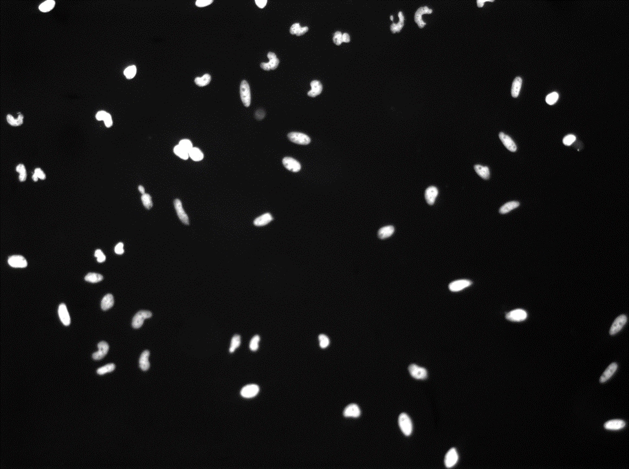

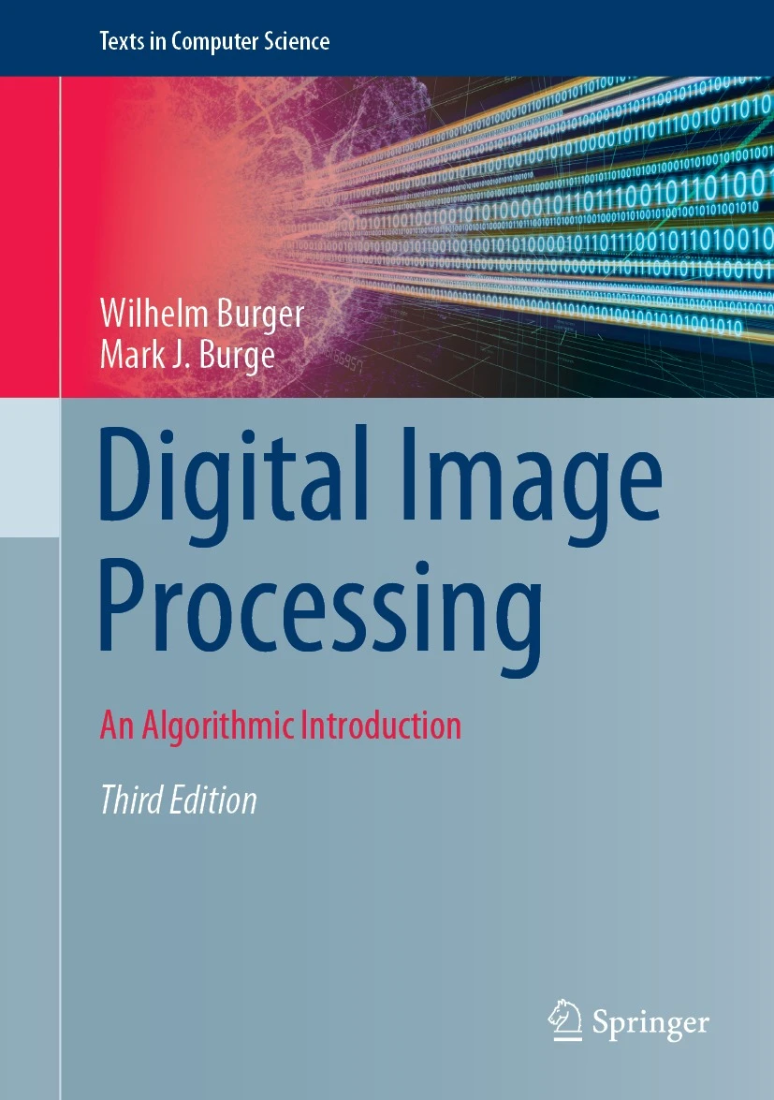
“Solutions to image analysis problems often appear simple, particularly when easily accomplished by the human visual system, which is complex and poorly understood.”

Slide 39
Rule #5: Manage your expectations

Slide 40
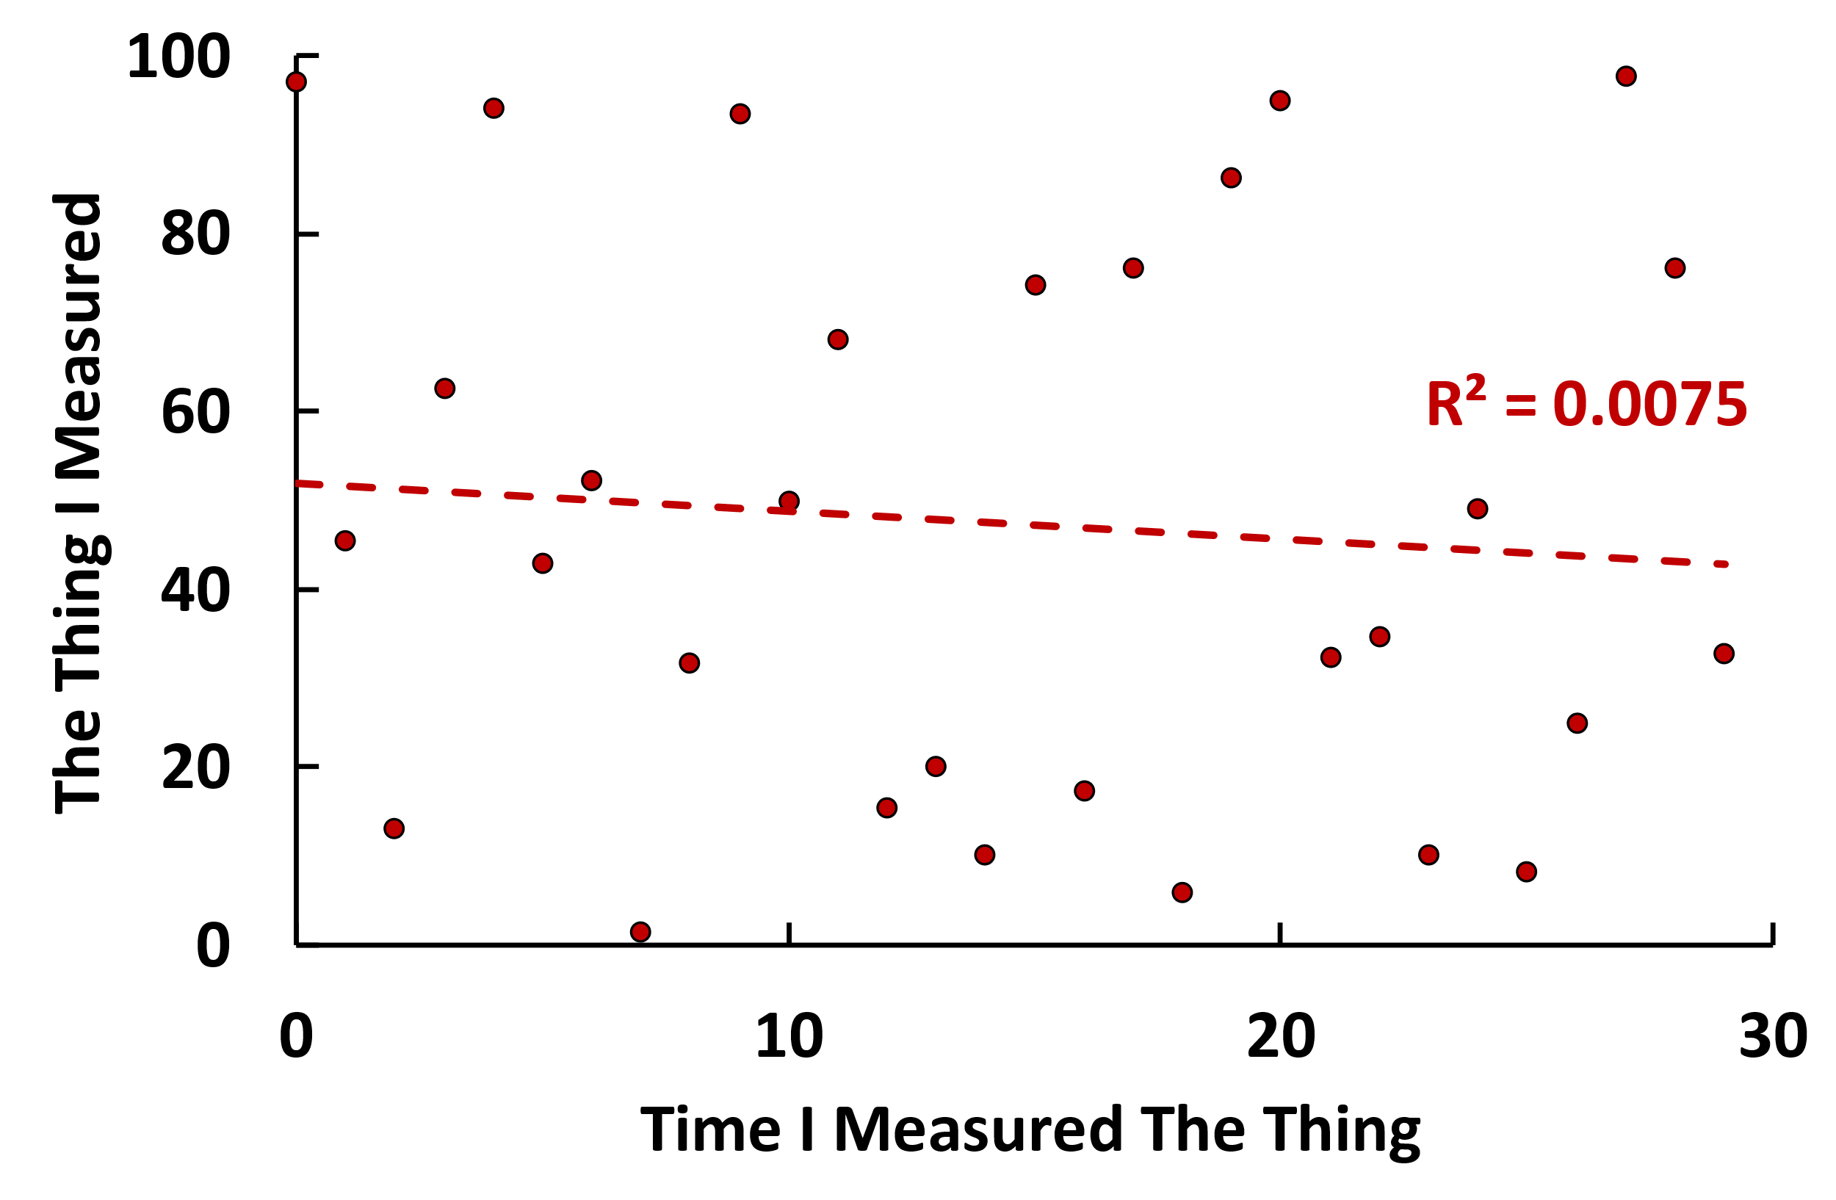
Design Experiment
Prepare Samples
Acquire Images
Analyse Images

Slide 41

Design Experiment
Prepare Samples
Acquire Images
Analyse Images
DESPAIR

Slide 42
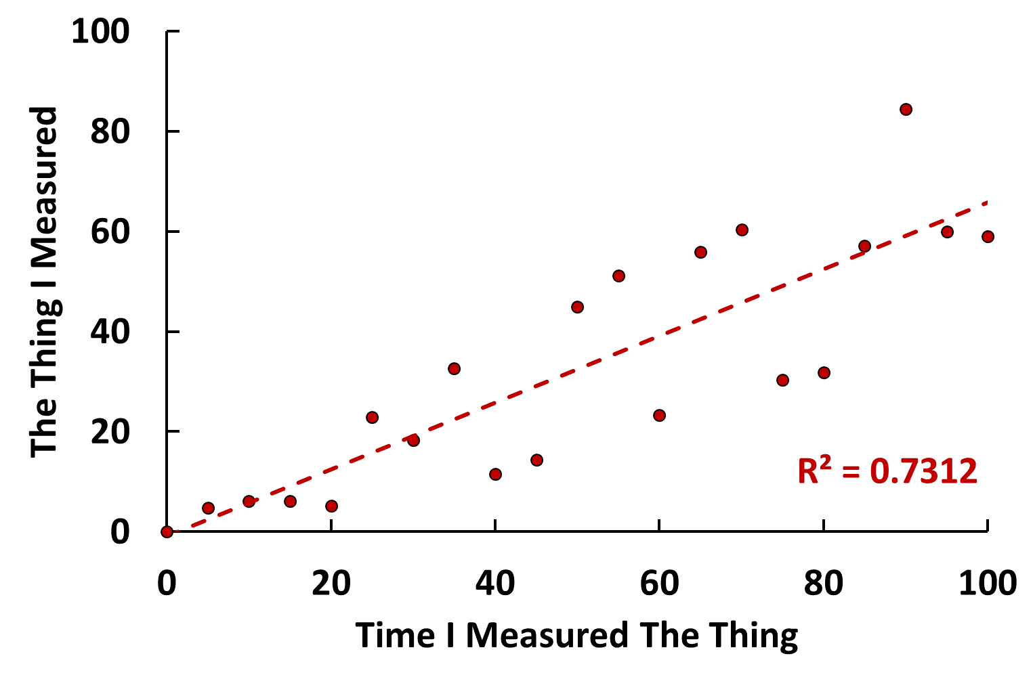

Design Experiment
Prepare Samples
Acquire Images
Analyse Images
GLIMMER OF HOPE

Slide 43

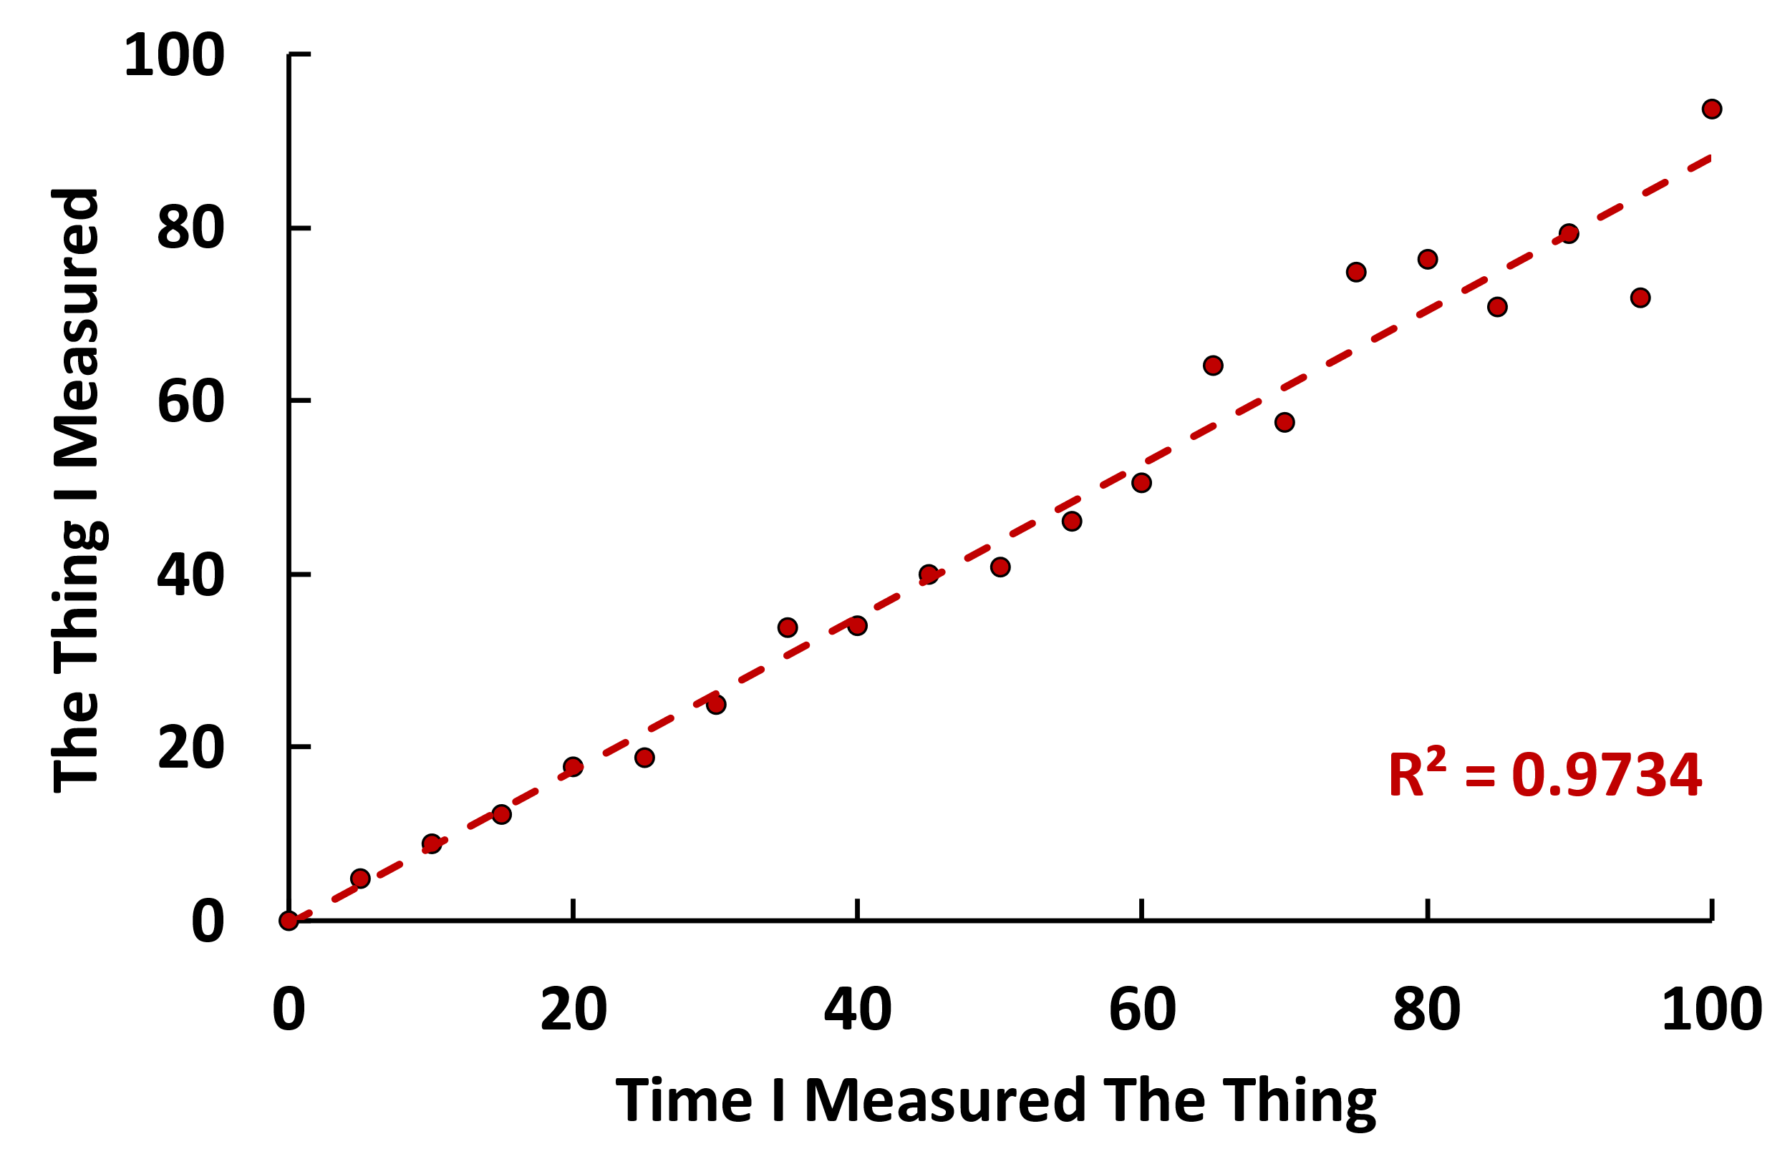

Slide 44
Rule #6: Perfect is the enemy of good

Slide 45
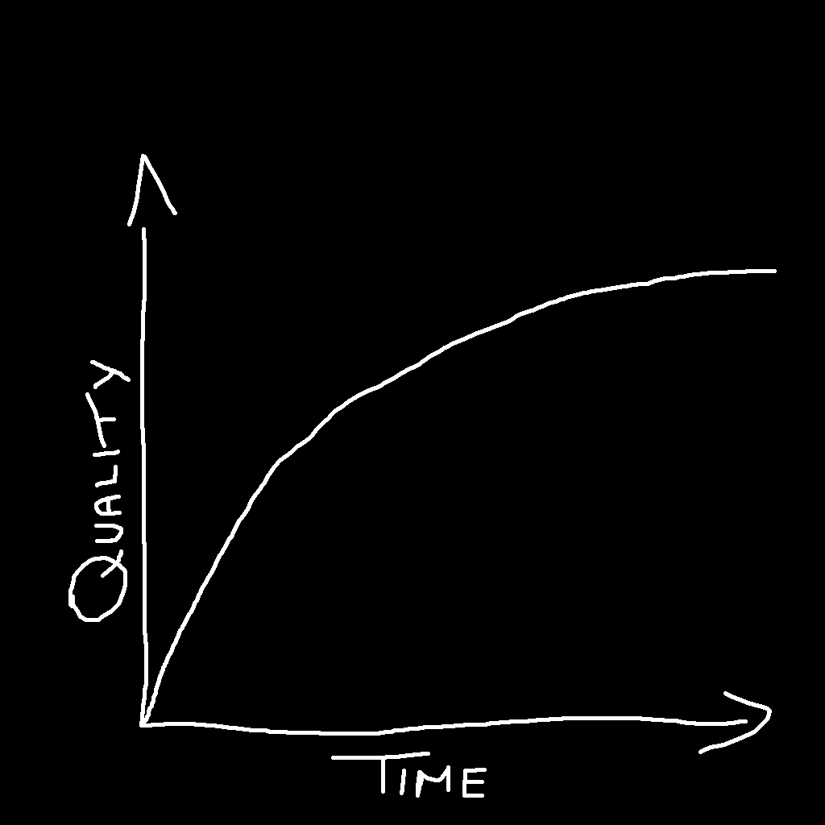
When do I know when my image analysis is good enough?

Slide 46


Everyone makes mistakes

Slide 48
Rule #6: Analyse first, ask questions later

Slide 49
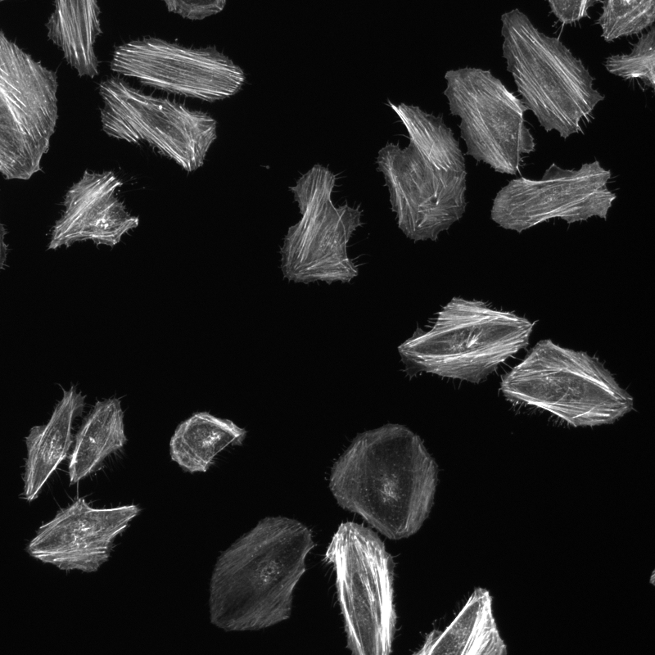
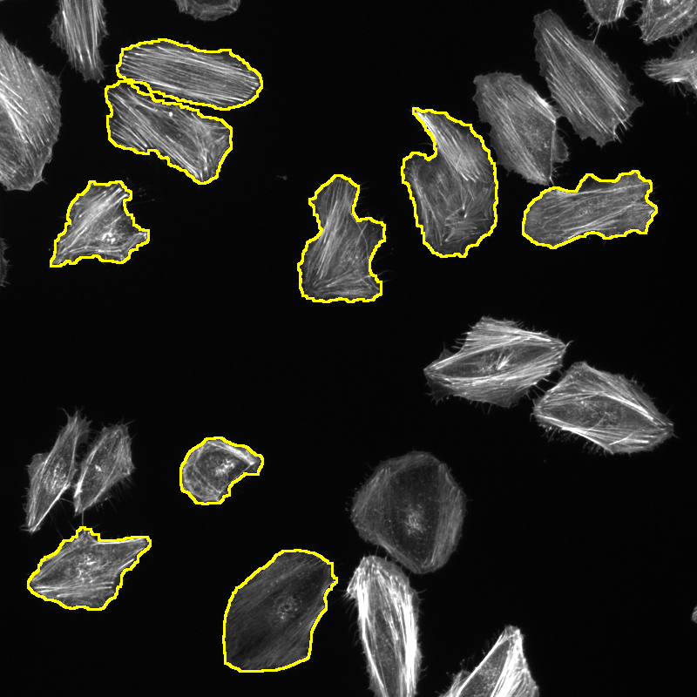
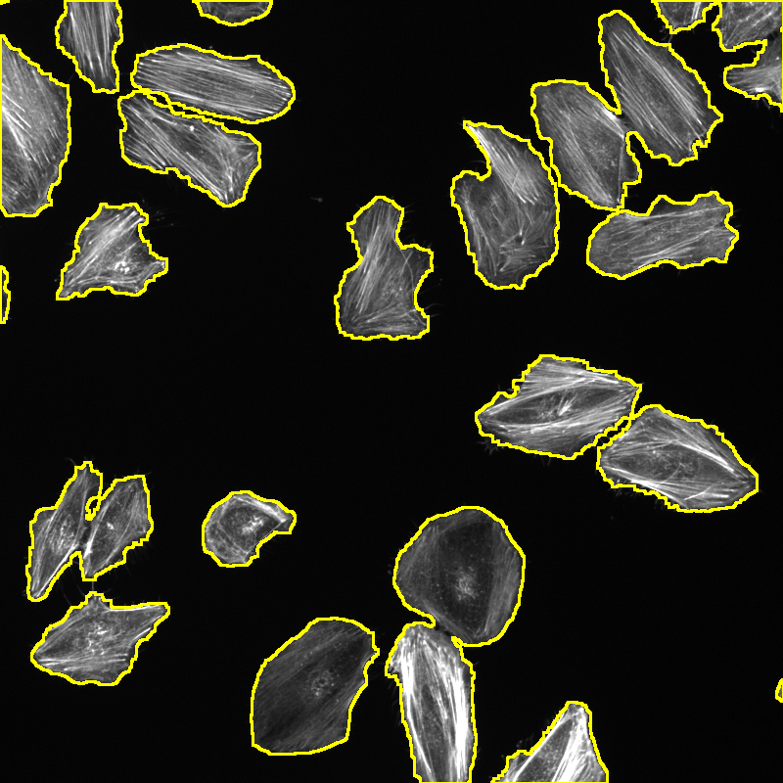

Slide 50



Slide 51
Rule #7: Crap In = Crap Out

Slide 52
Crap Images
Super Cool, State-of-the-Art, Cutting Edge Image Analysis Pipeline
Crap

Slide 53

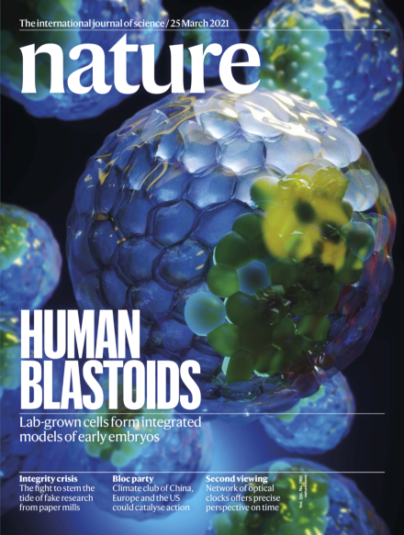
Crap Images

Slide 54
Compulsory Slides on Machine Learning

Slide 55
Rule #8: AI is but one of many tools

Slide 56
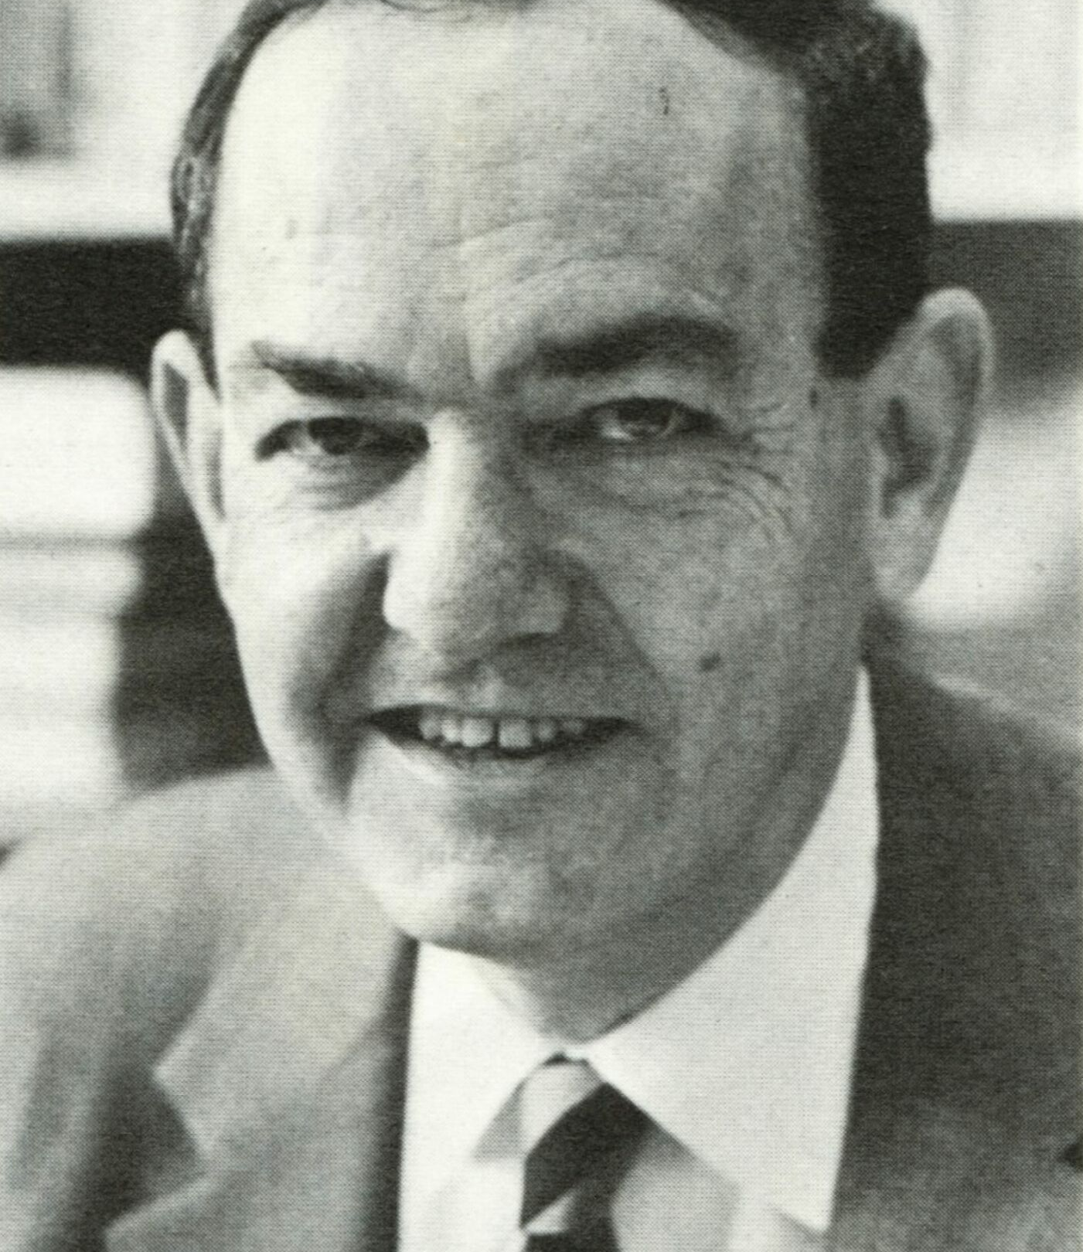
“machines will be capable, within twenty years, of doing any work a man can do”
Herbert Simon, 1965

Slide 57
AI Needs lots of training data
E.g. AlphaFold
Took 50 years to collect at an estimate cost of $12 billion
Images from biological experiments tend to be less well-structured

Slide 59
“Conventional” Pipeline
AI Pipeline

Slide 60
Rule #9: Use the right tool for the right job

Slide 61


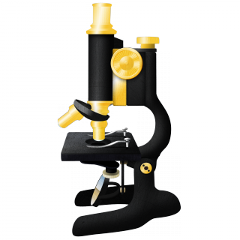





Slide 62
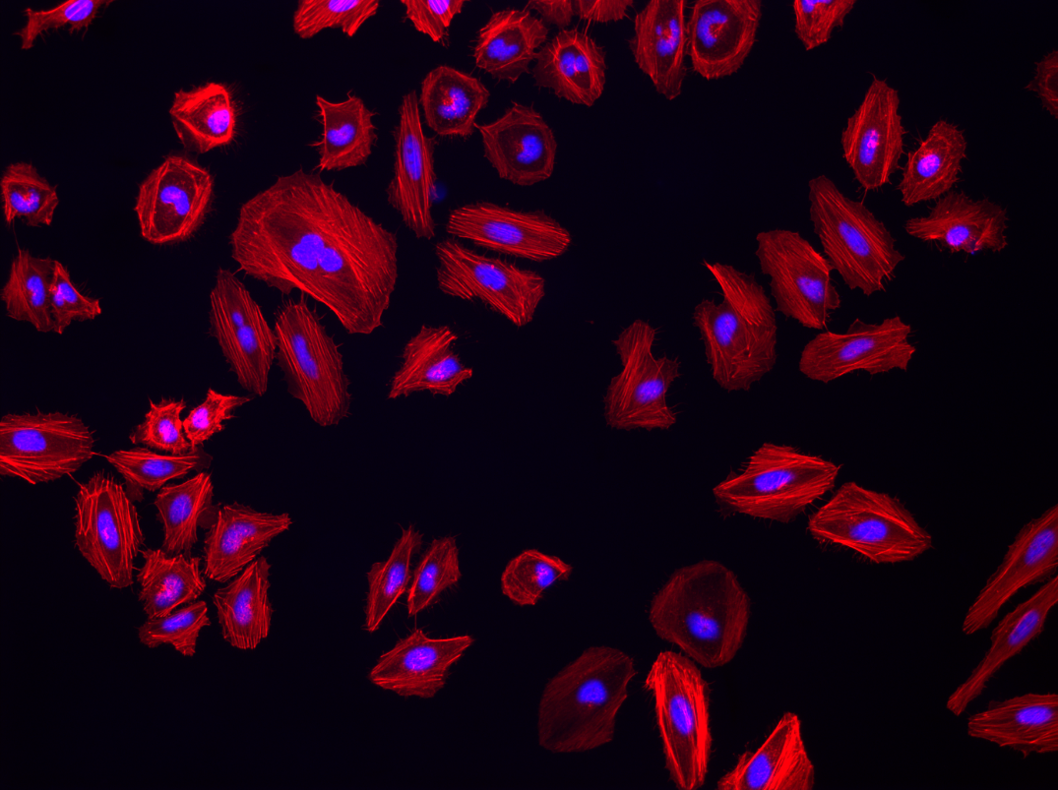
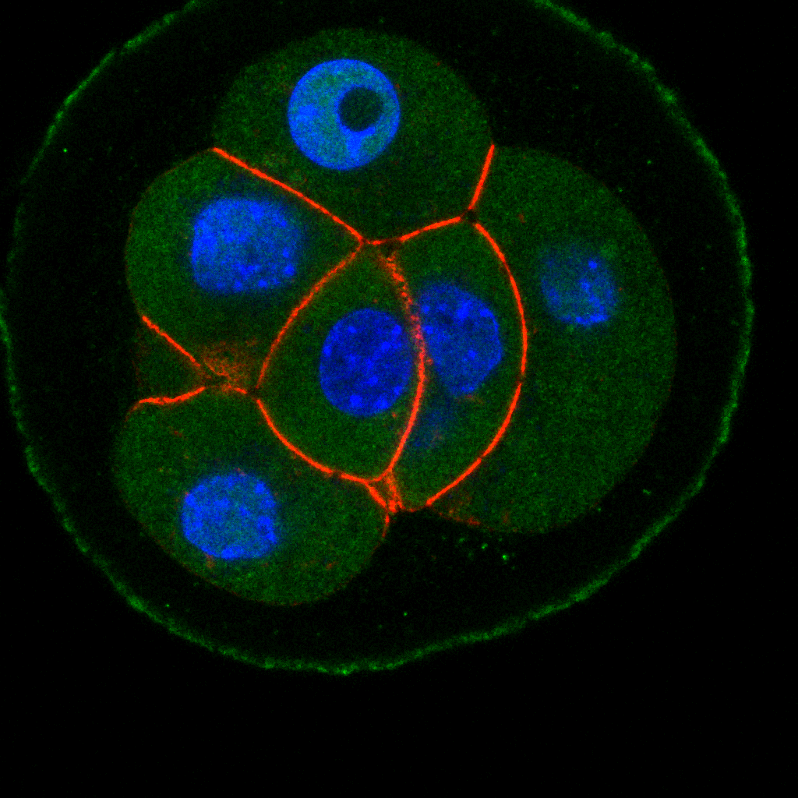
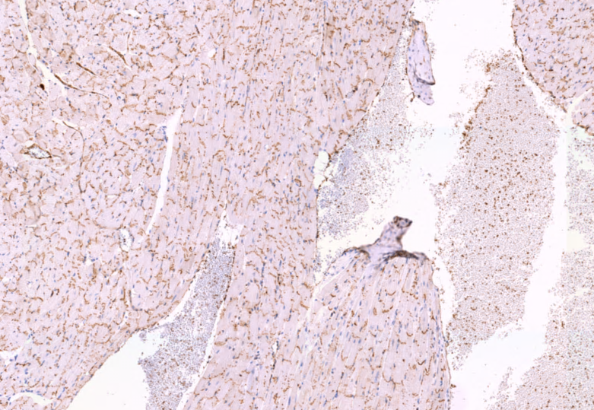
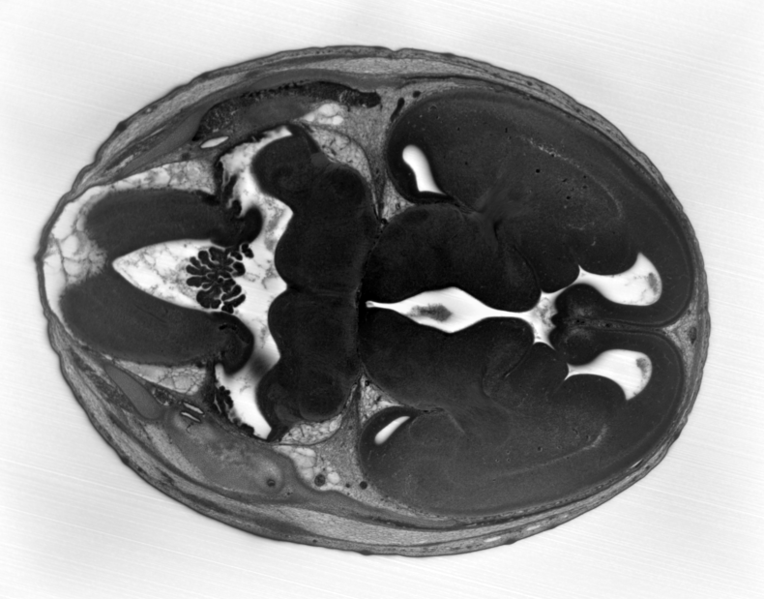

Slide 63
Rule #9b: Avoid software that is only “available on request”

Slide 64
Rule #9c: Avoid poorly-documented software

Slide 65


Slide 66
Rule #9d: Avoid inactively-maintained software

Slide 67
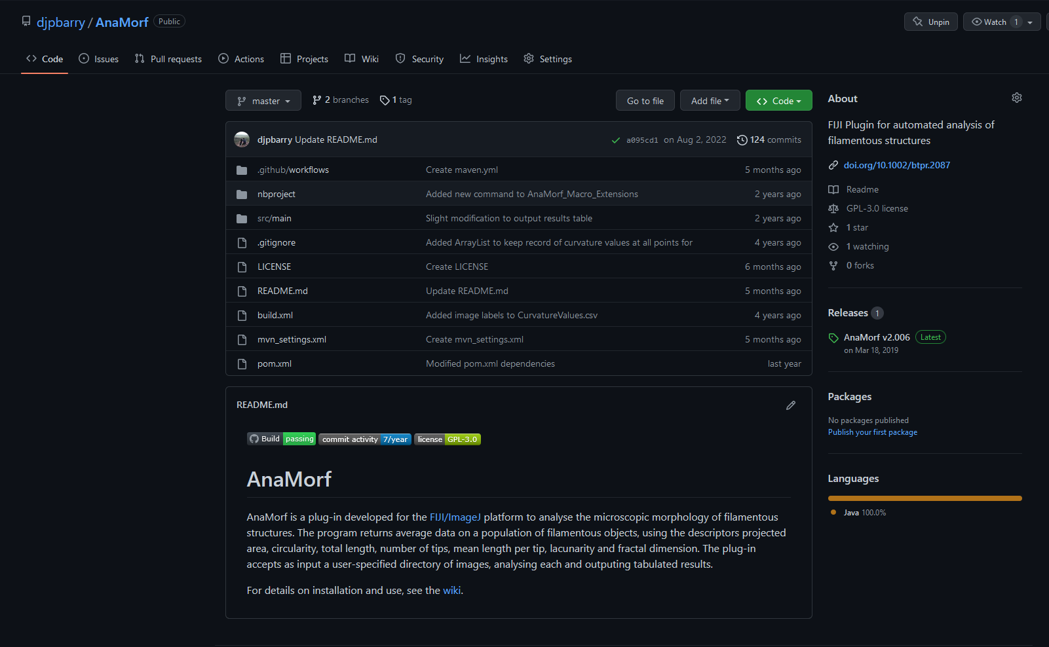

Slide 69
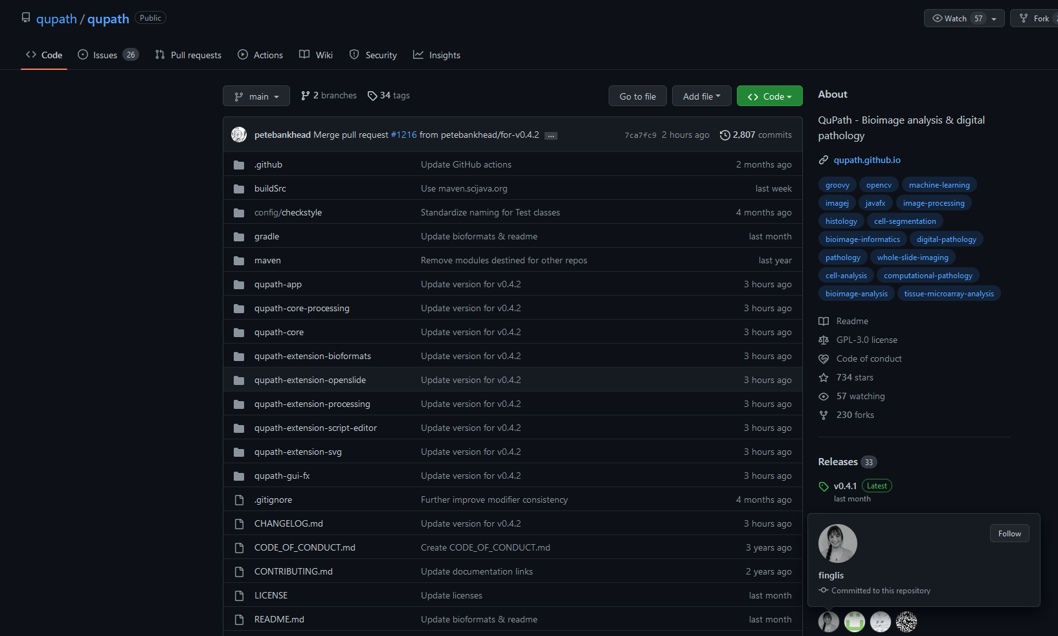

Slide 70
Rule #10: Ask For Help!

Slide 71
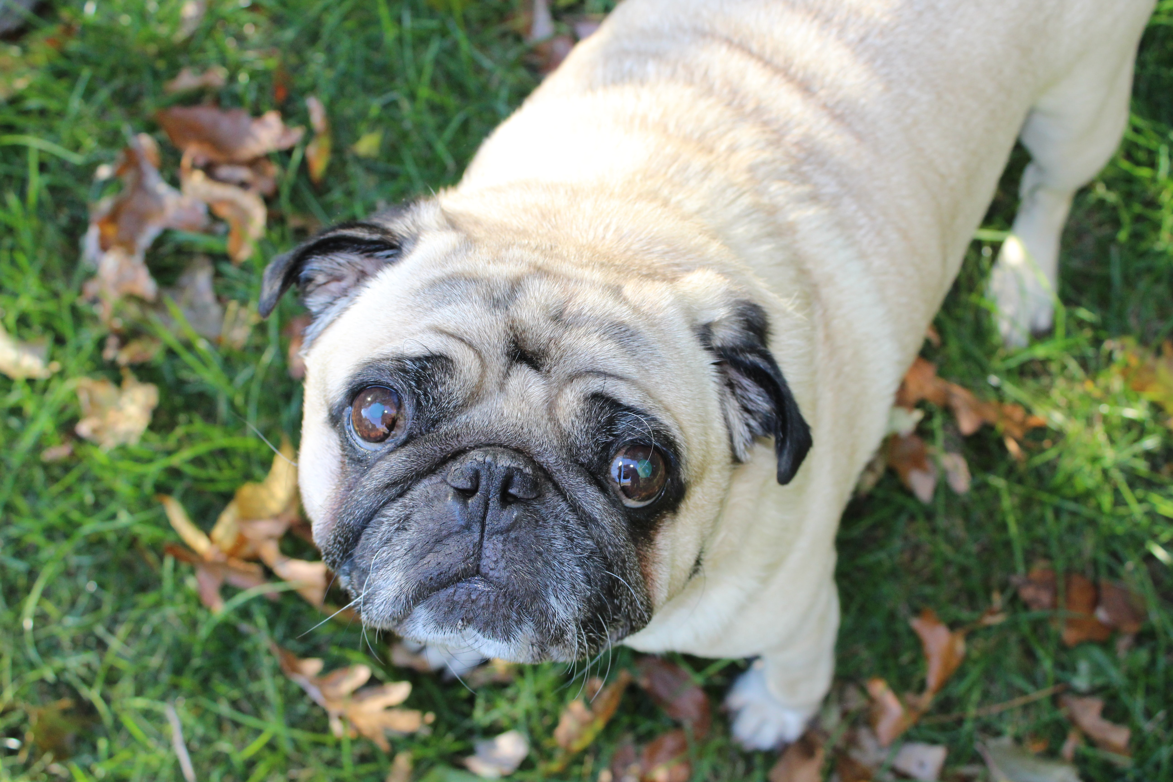

I have literally no idea what I’m doing…

Slide 72
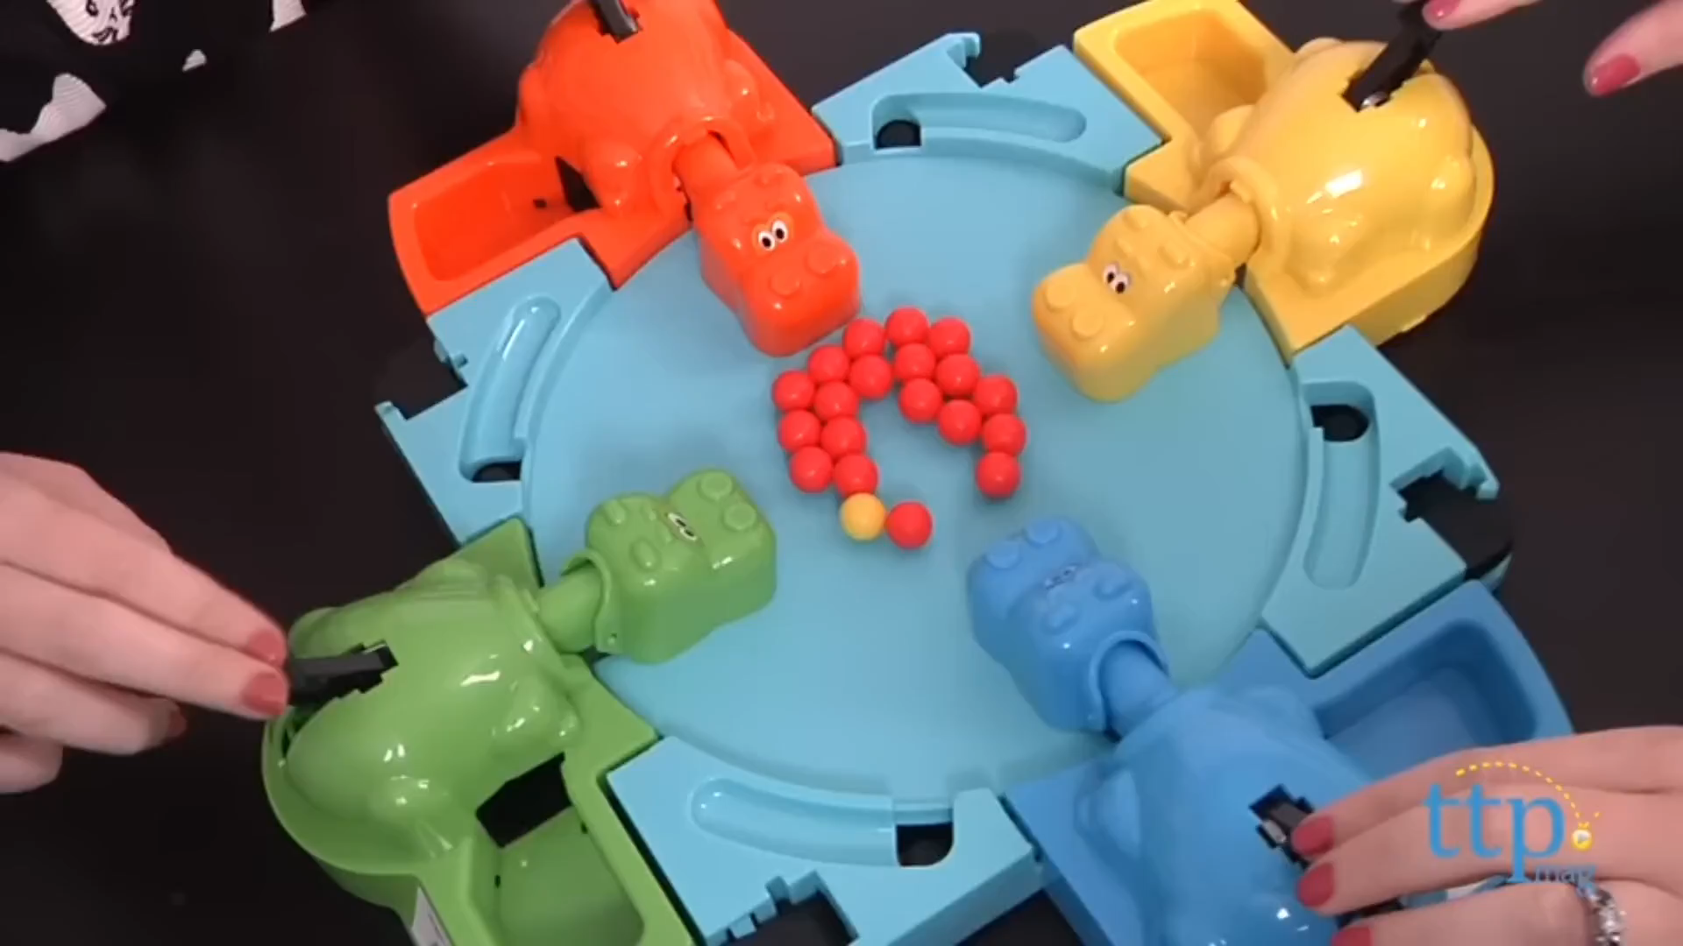
Now we have ALL the data!!!
Ok, now what?
Naughty Scientists
Microscopy Images
DEEP LEARNING!!!

Slide 73
Rule #10: Ask For Help!
Yes, but HOW?!?

Slide 74
?

Slide 75
?
?

Slide 77


Slide 78
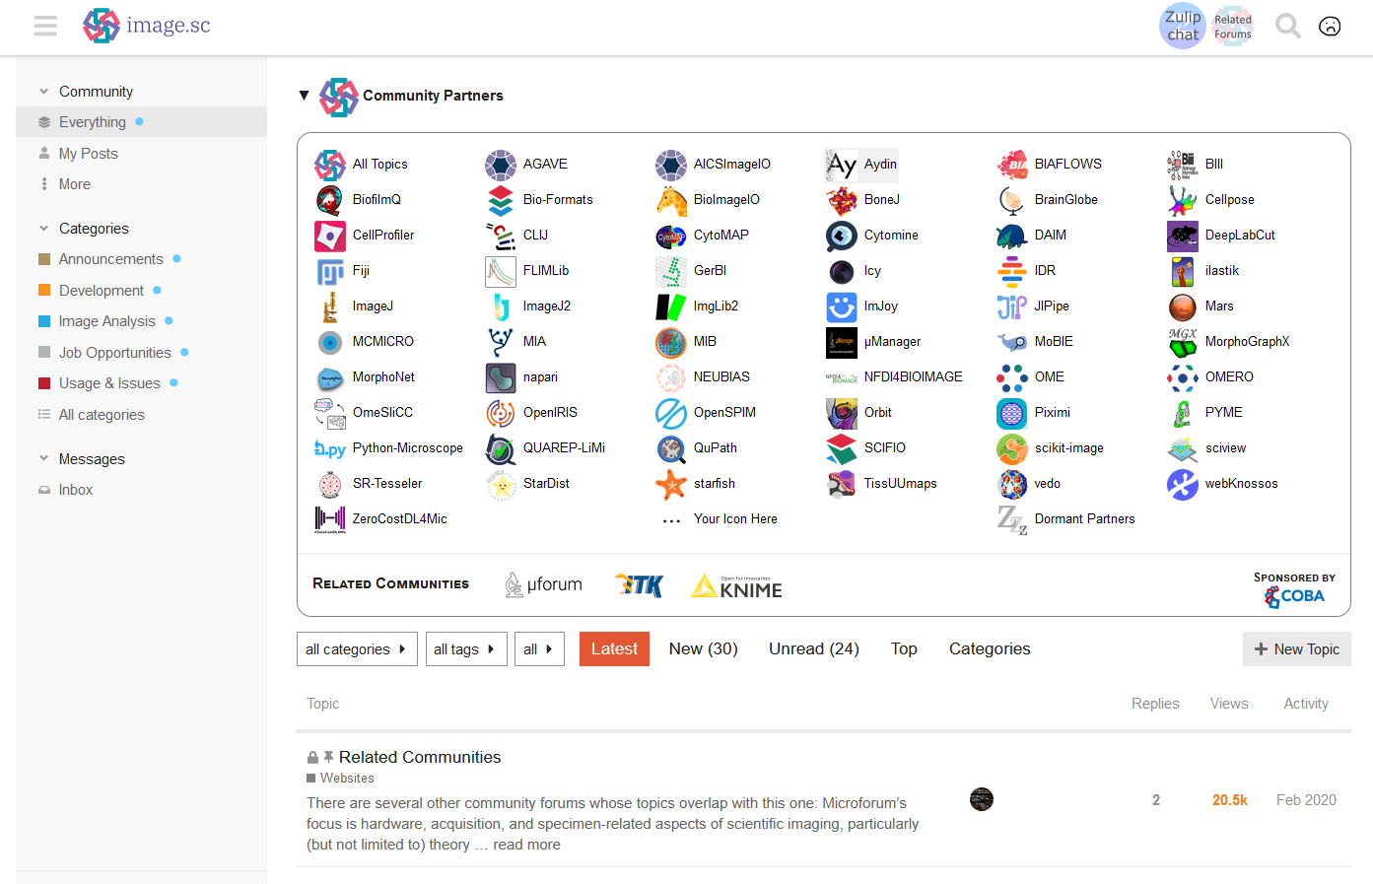
forum.image.sc

Slide 79
Rule #10: Ask For Help!
Great!
Anything I shouldn’t do?

Slide 80

My revised manuscript is due tomorrow!

Slide 81
Rule #11: Don’t ask us to confirm what you can “clearly see by eye”.

Slide 82
Rule #1: Seeing is not believing

Slide 83
Rule #1: Quantitative data is believing

Slide 84
Rule #1: Quantitative data is adding to the body of scientific evidence

Slide 85
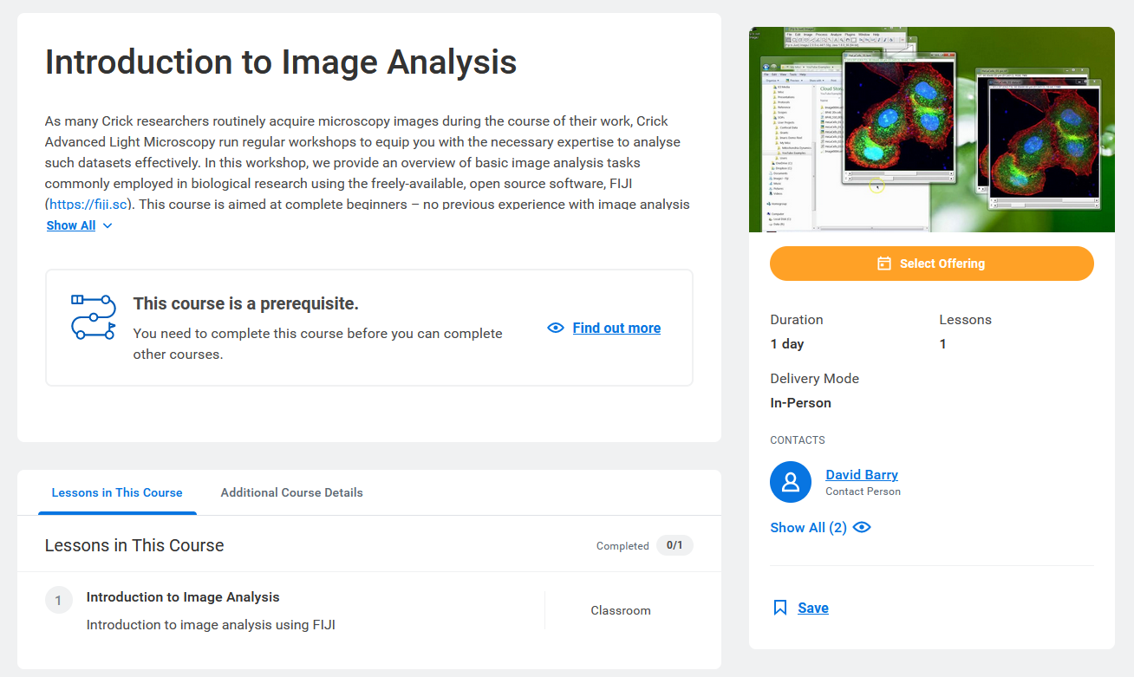

Slide 86
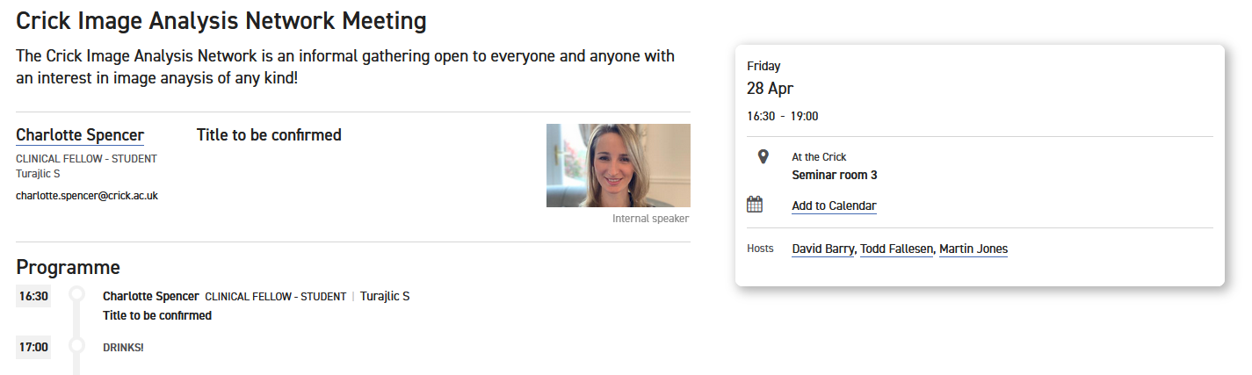

Slide 87

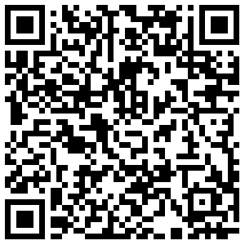
20 – 21 November 2023

Slide 88
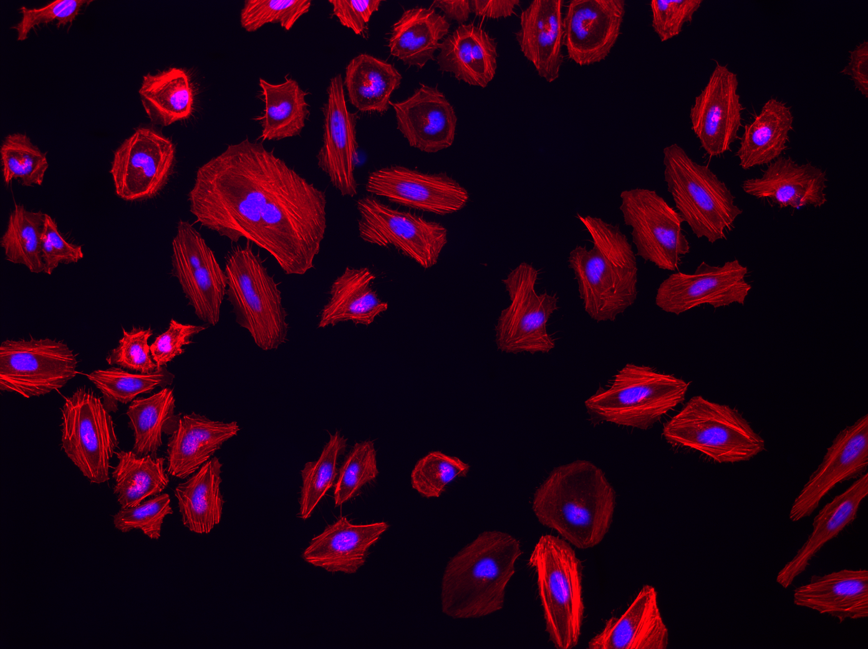


Thanks for Listening!
david.barry@crick.ac.uk

